Slide 1
Do layoff posts really help?
Mia Vo
DATA 400
Prof. Bilen

Slide 2
Table
of Content
1
DATA summary
2
Text analysis
3
Classification models
4
Challenges and next steps

Slide 3
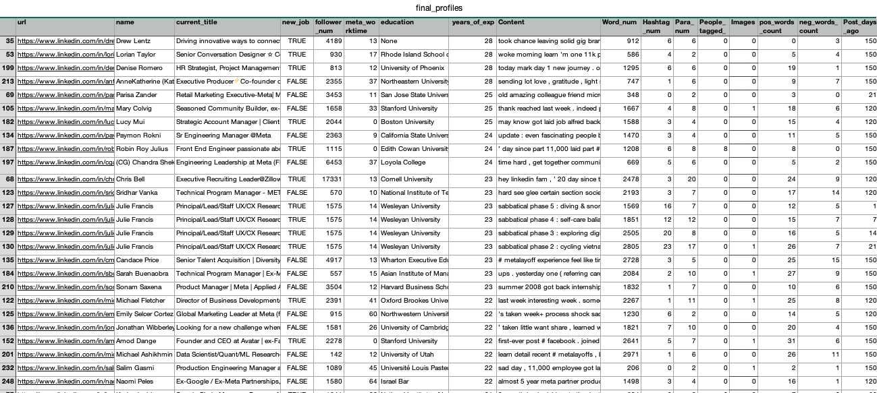
1. Data Summary

Slide 4
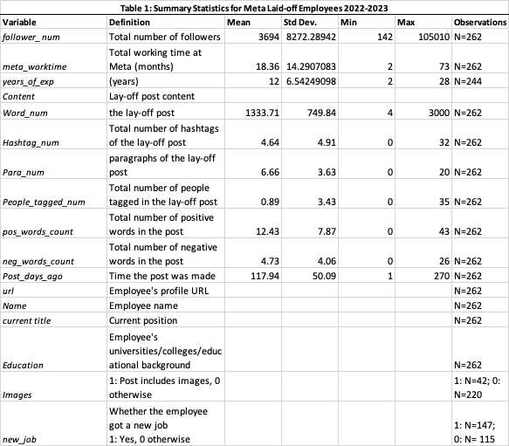
1. Data Summary

Slide 5
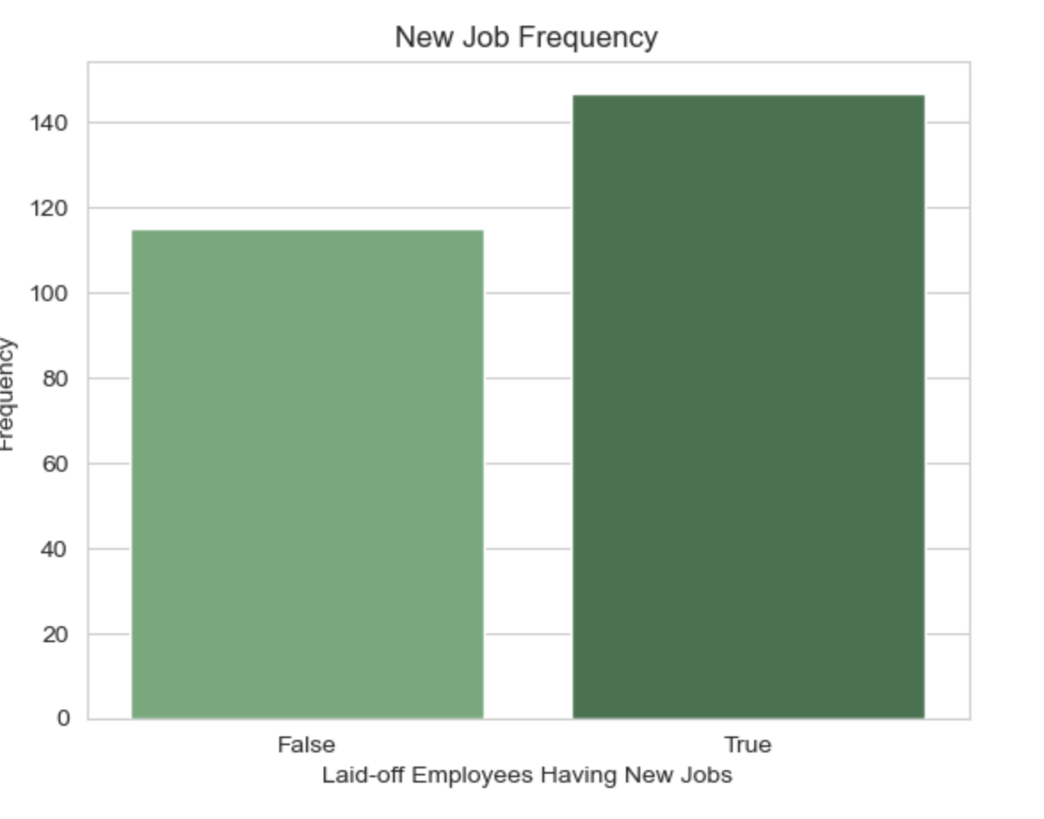
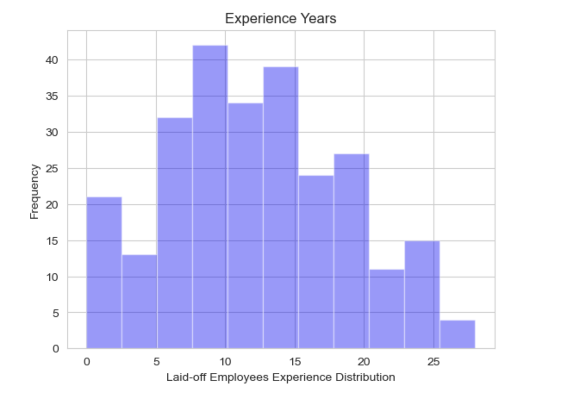
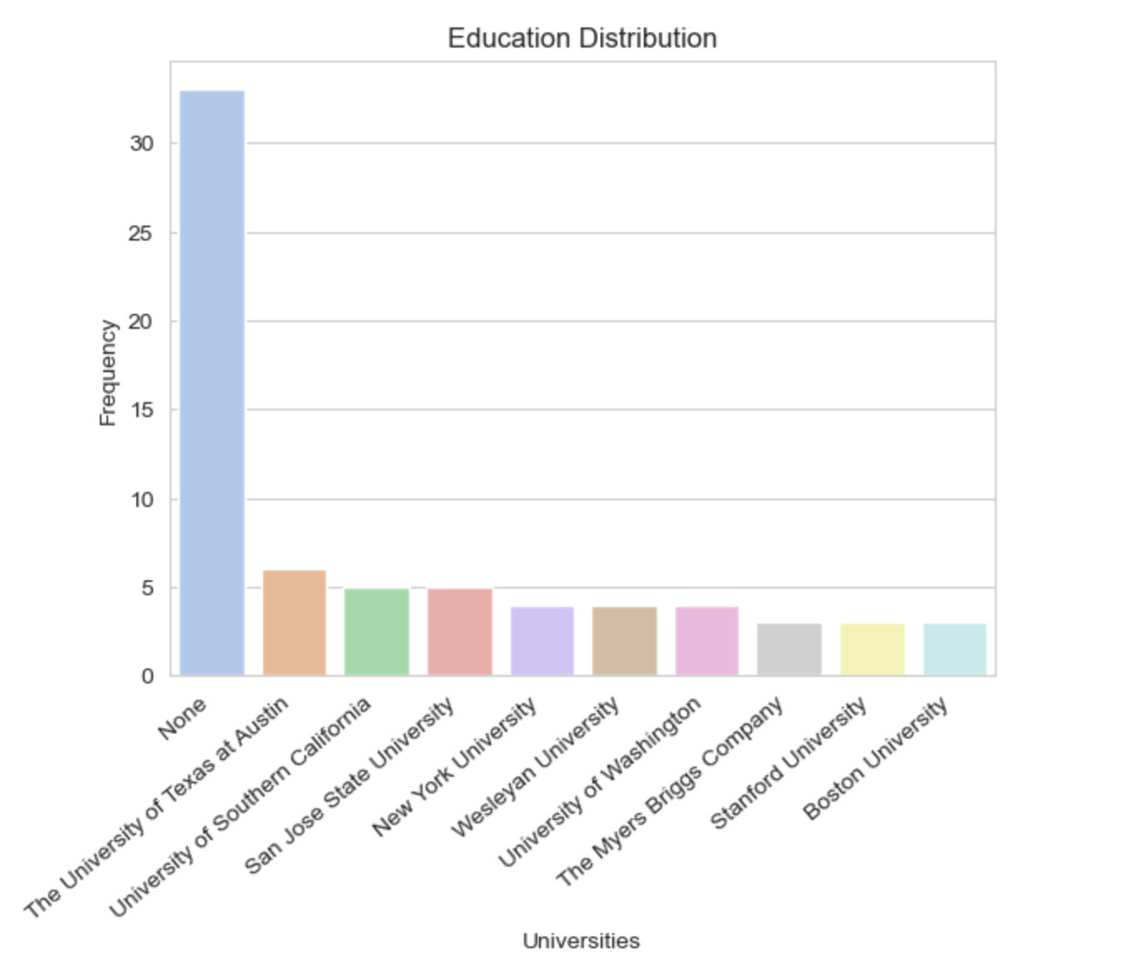
1. Data Summary
Personal Data

Slide 6
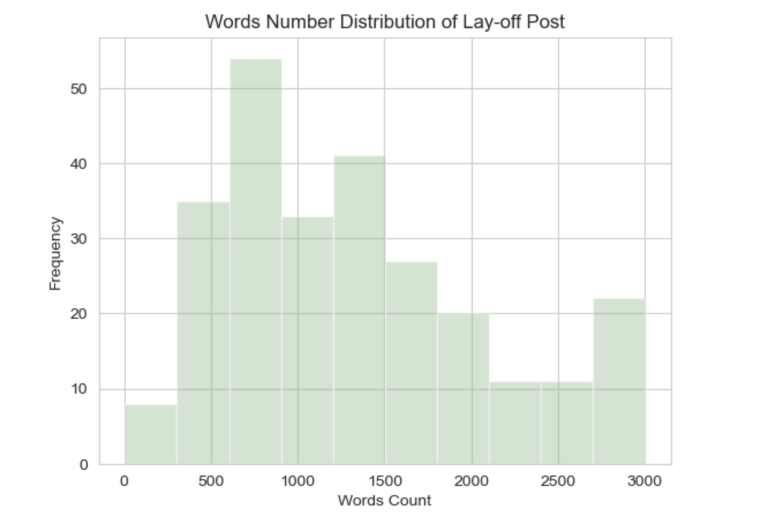
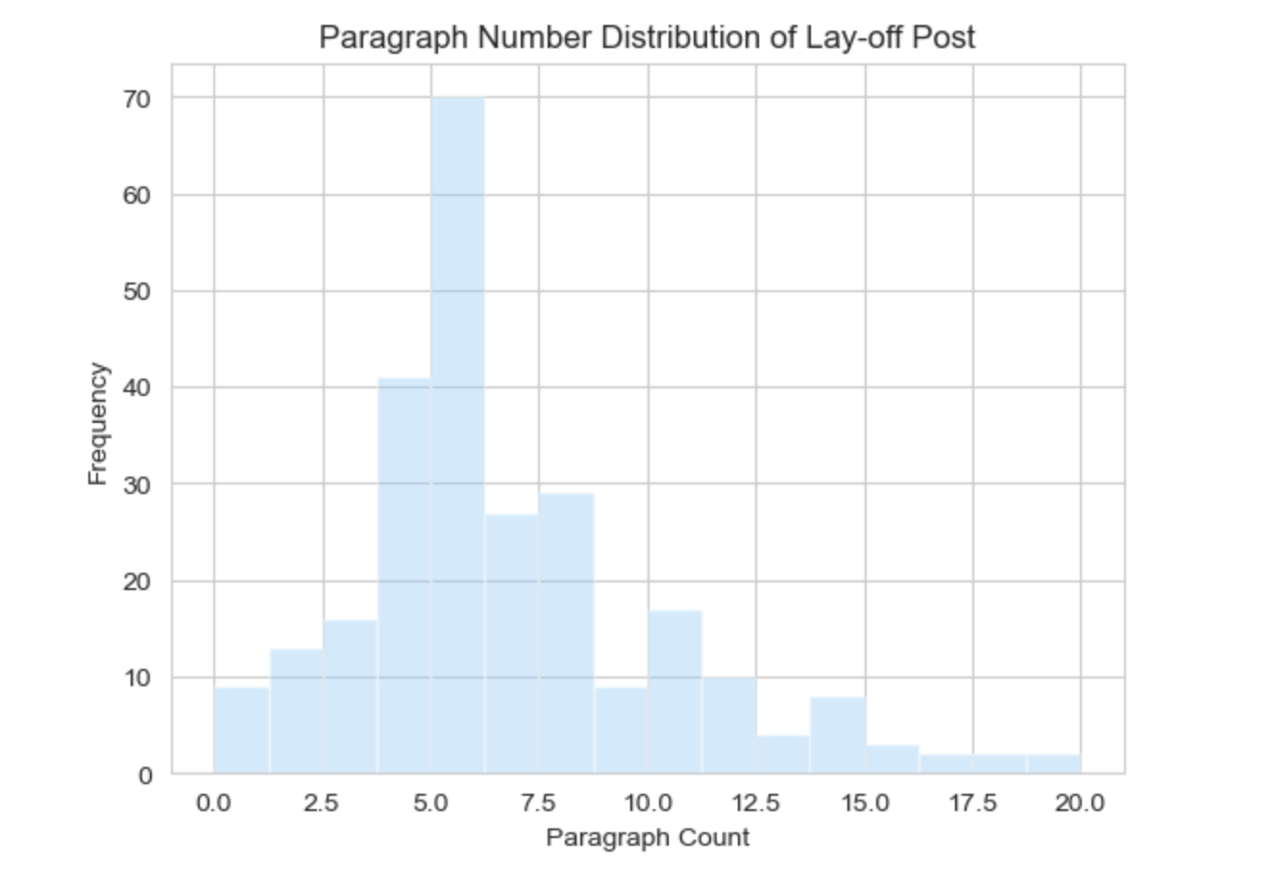
1. Data Summary
Post Data

Slide 7
Research Question
2. Text Analysis
What content should be included in the LinkedIn lay-off announcement post to help employees get a job?
Notes:
Reasons I care: utlize LinkedIn
For firms: hub to find the employees
For employees:
Find opportunities
Community to share, get to know each other, support mentally -> efficiently what to include, inforsharing easier

Slide 8
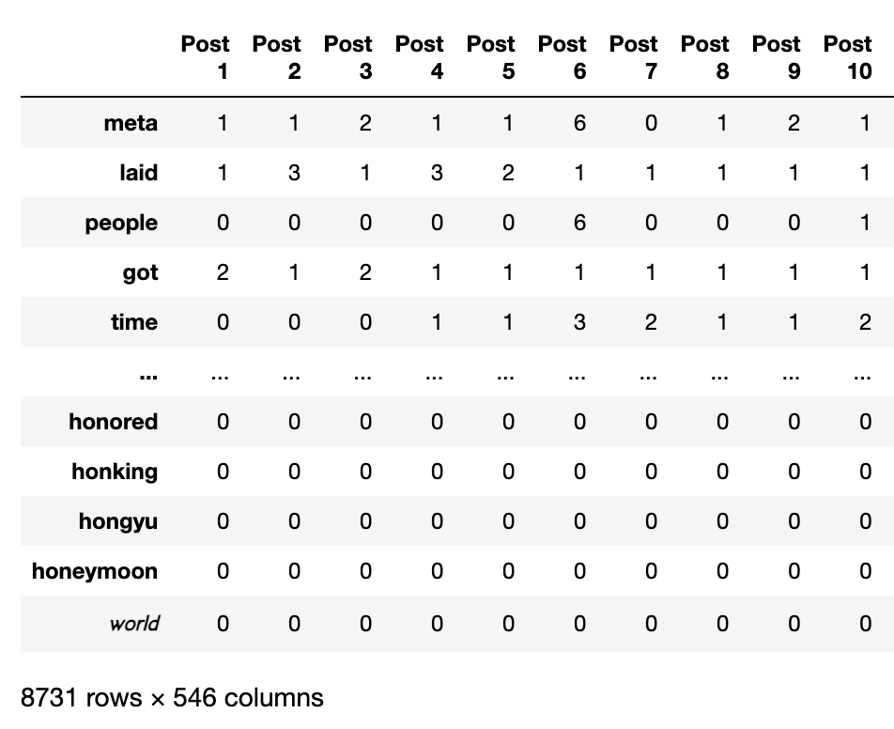
2. Text Analysis
NLP Package
Preprocess to tokenize post, remove stop words
Count the frequency of each word and present by each post
Match with positive and negative words lists, sum by column

Slide 9
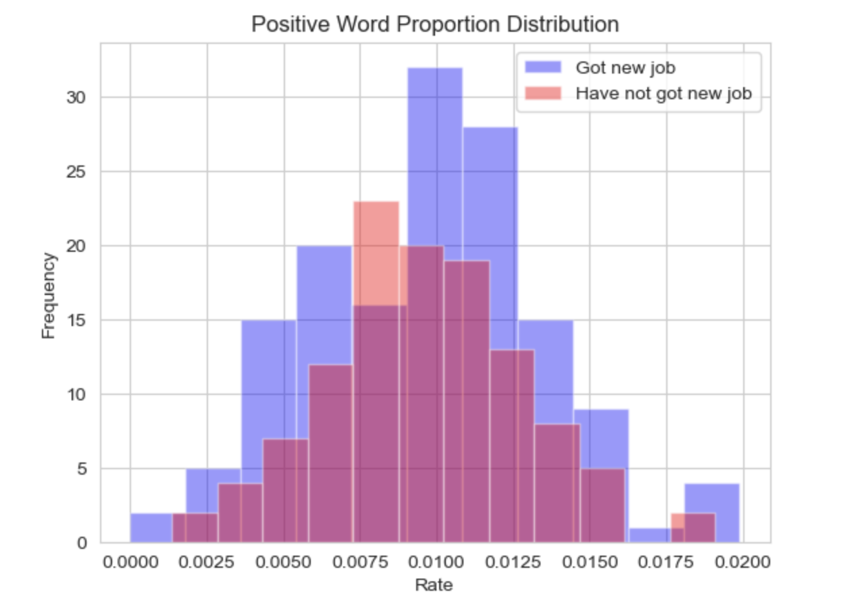
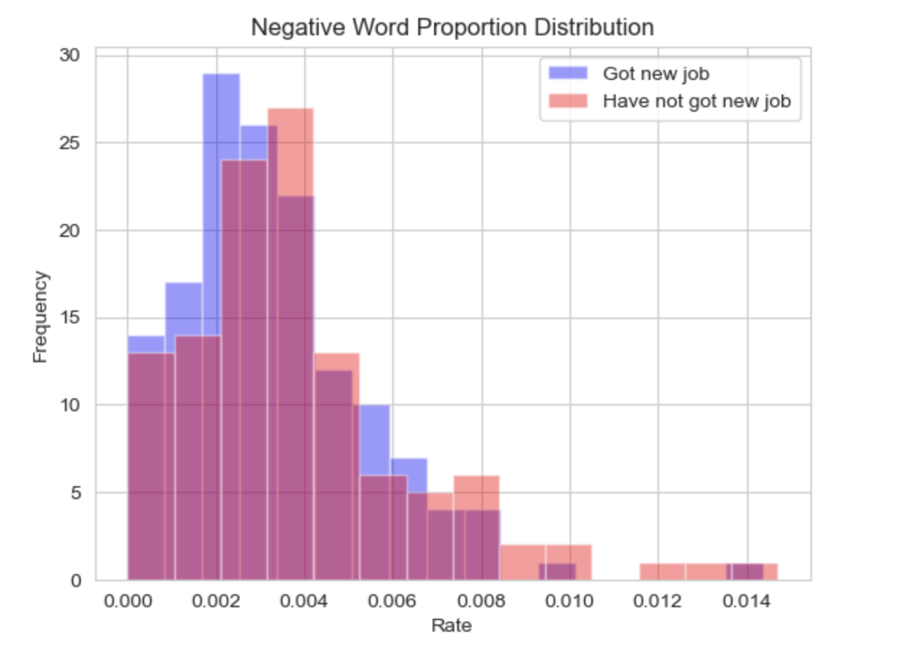
2. Text Analysis
NLP Package

Slide 10
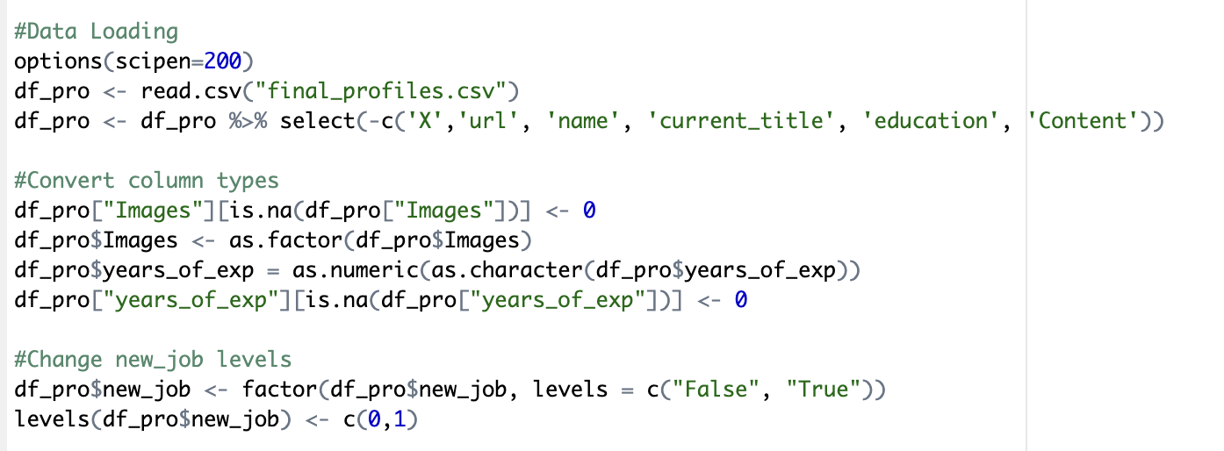
3. Classication
R Cleaning
Eliminate categorical variables
Replace NaN values with 0
Convert dummy variables to categorical
Set the level for new_job variable
Split into training and test sets

Slide 11
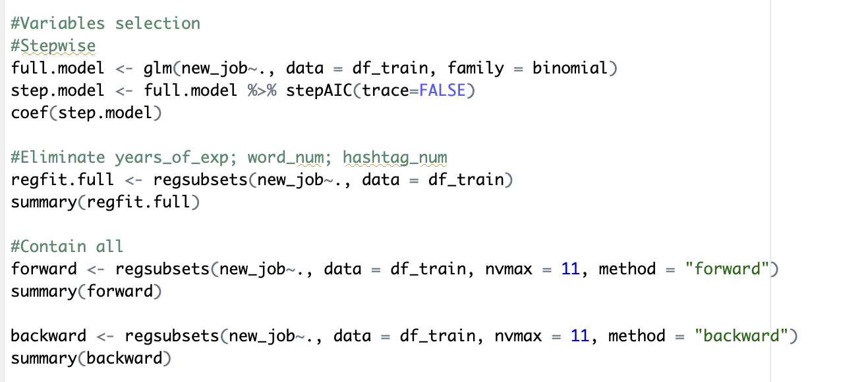
3. Classication
Variables Selection
Stepwise Selection
Best subset
Forward
Backward

Slide 12

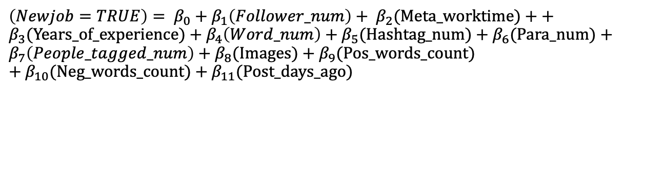
Full Regression Model
3. Classication
$\left(Newjob=TRUE\right)= β_{0}$ + $β_{1}\left(Follower_num\right)+ β_{2}$(Meta_worktime) + + $β_{3}$(Years_of_experience) + $β_{4}\left(Word_num\right)+β_{5}$(Hashtag_num) + $β_{6}$(Para_num) + $β_{7}\left(People_tagged_num\right)+β_{8}$(Images) + $β_{9}$(Pos_words_count) $+β_{10}$(Neg_words_count) + $β_{11}$(Post_days_ago)
Best subset Model
$\left(Newjob=TRUE\right)= β_{0}$ + $β_{2}$(Meta_worktime) + $β_{4}\left(Word_num\right)+β_{5}$(Hashtag_num) + $β_{6}$(Para_num) $+β_{8}$(Images) + $β_{9}$(Pos_words_count) $+β_{10}$(Neg_words_count) + $β_{11}$(Post_days_ago)

Slide 13
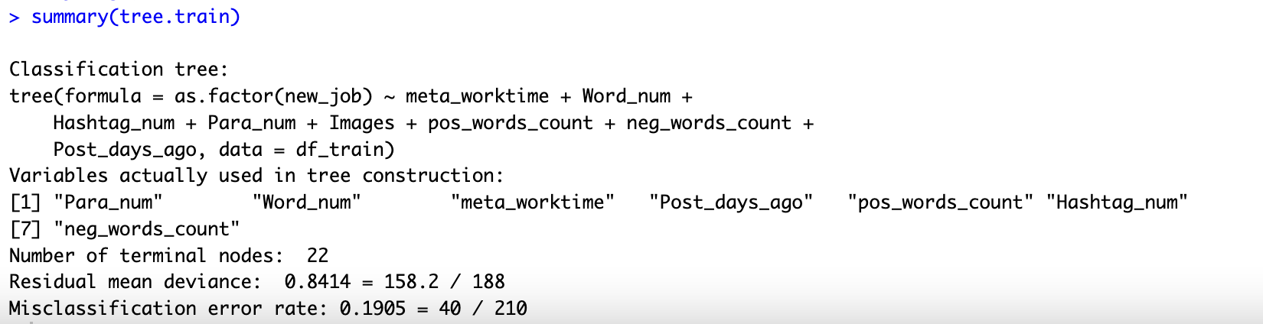
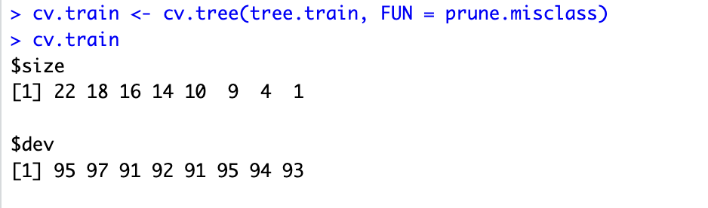
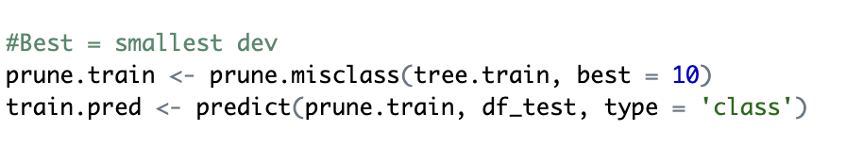
3. Classication
Classification Tree
Tree Pruning

Slide 14
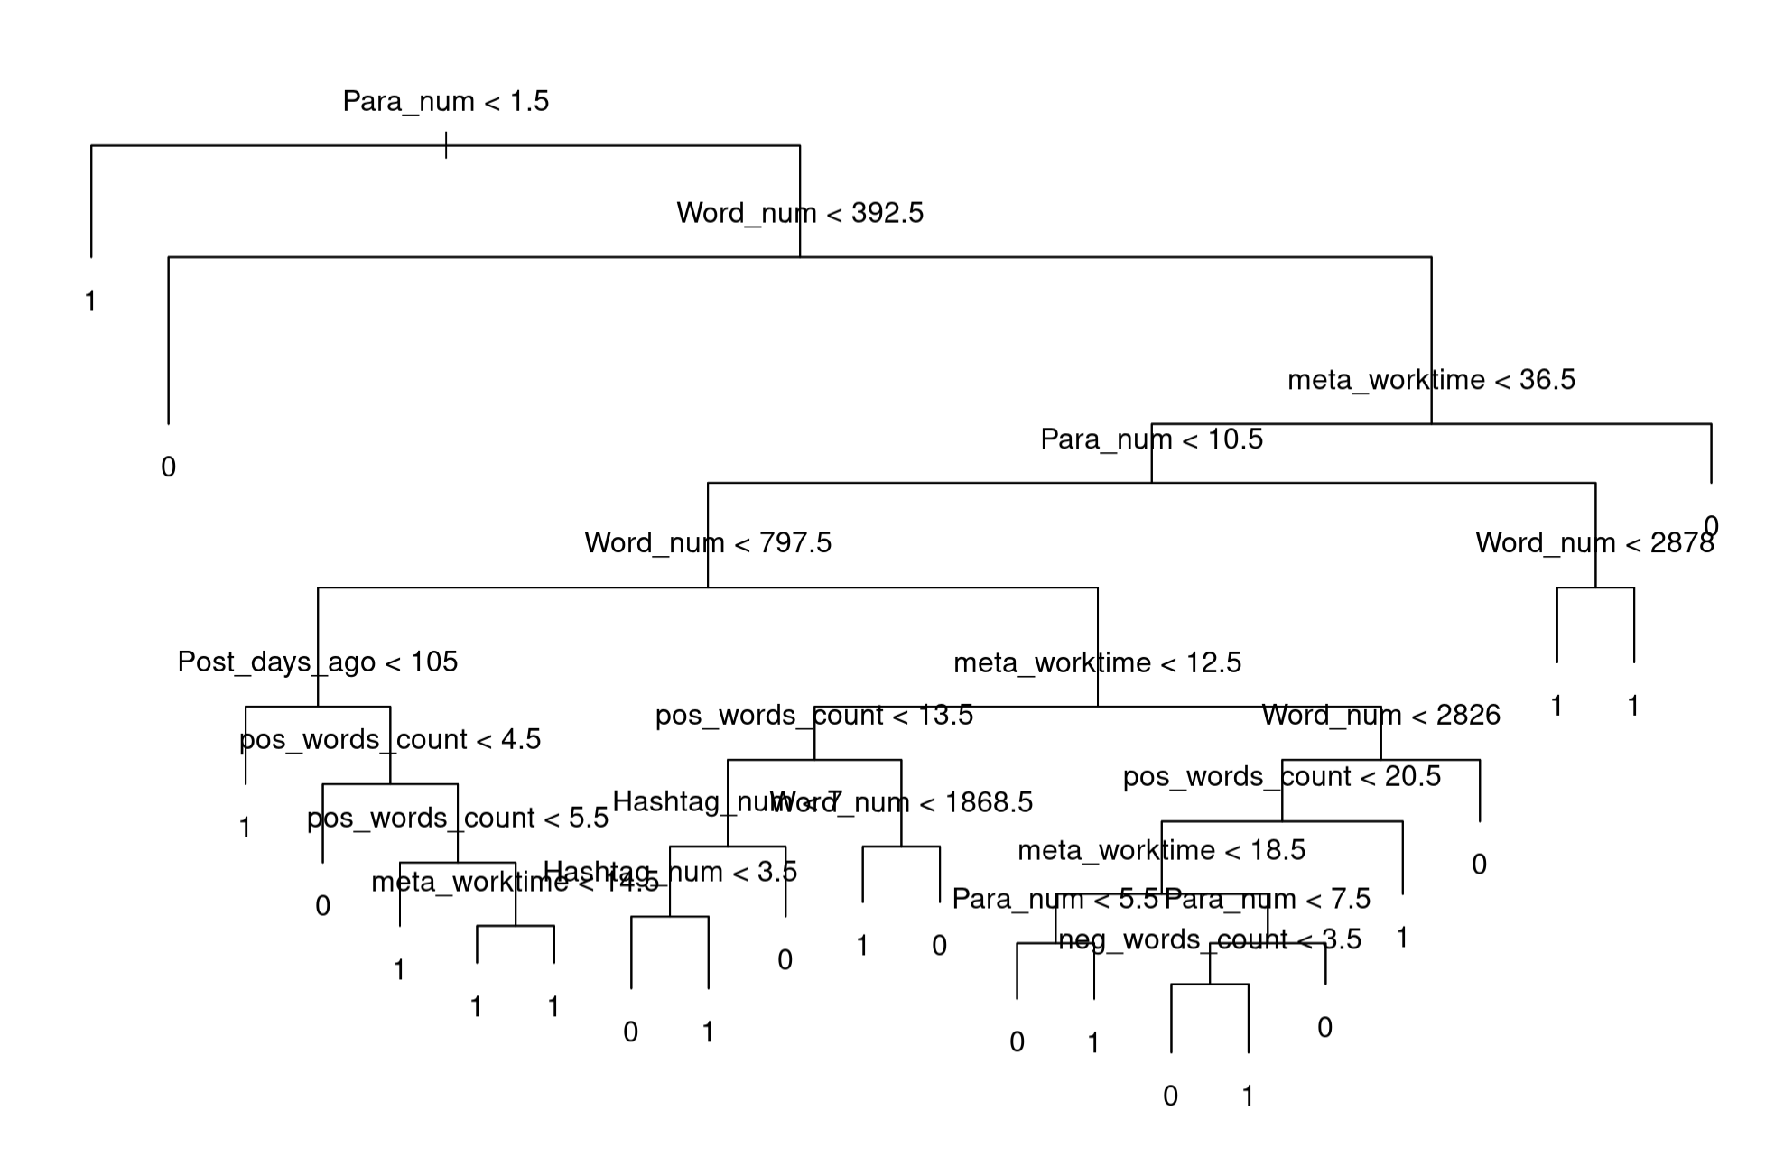
3. Classication

Slide 15
3. Classication
Classification Results
Stepwise Selection
Best subset
Forward
Backward
 | Logistic regression full model | Logistic regression best subset model | Classification Tree | Tree pruning | Boosting
Accuracy | 0.52 | 0.53 | 0.47 | 0.5 | 0.5
F-Score | 0.54 | 0.57 | 0.41 | 0.59375 | 0.67

Slide 16
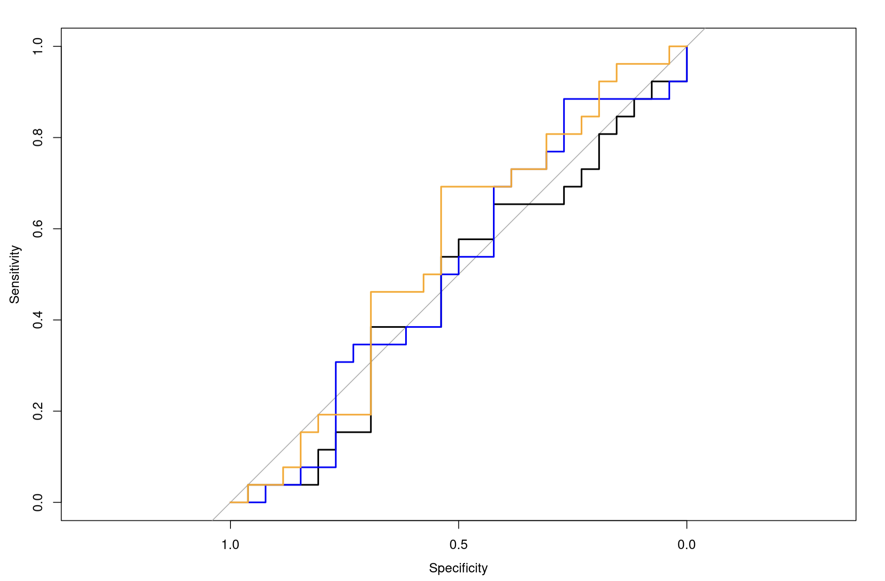
3. Classication
Classification Results
 | AUC Score
Logistic regression | 0.4704
LDA | 0.503
QDA | 0.5488

Slide 17
Next Steps
4. Next Steps
Scrape full data, scale up to 1000 profiles
Add more sentiment variables and do text analysis by topics
Visualize results

